Slide 1

Health Insurance Updates
Kelly Harding
Christina Heckathorn

Slide 2
Medicare Part D
  Individuals who are eligible for Medicare must have creditable coverage or they will pay late enrollment penalties
  Employers do not have to offer creditable coverage, just provide notice to employees and spouses
  2026 out of pocket maximum of $2,100 potentially makes Medicare more attractive than group plans for certain Medicare eligible individuals
  Group health plans must provide a notice of creditable coverage to employees by October 15th
  Keep in mind that if your plan was previously “creditable,” it may not be upon renewal in 2026
Creditable coverage = coverage at least as good as Part D

Slide 3
Gag Clause: Attestation Requirements
Purpose: Prohibiting health plans from entering contracts with carriers, TPAs, network and service providers, or others that inhibit a plan’s right to know cost or quality of care information.
Deadline: December 31, 2025
The plan must attest that it has not agreed to any restrictions on:
The disclosure of provider-specific cost or quality of care information or data to referring providers, the plan sponsor, participants, beneficiaries or enrollees, or individuals eligible to become participants, beneficiaries or enrollees of the plan or coverage;
Electronic access to de-identified claims and encounter information or data for each participant, beneficiary or enrollee upon request; and
Sharing information or data described in (1) and (2), or directing that such information or data
be shared with a HIPAA business associate, consistent with applicable privacy regulations.
How is the attestation submitted?
Via the HIOS site: Gag Clause Attestation | Welcome! (cms.gov)
Note: Anthem will file the attestation for KACO Association Health Plan groups

Slide 4
ACA Reporting
Who Reports | Form(s) Required | Due Date
Small employer, insured plan | No filing required; carrier distributes Form 1094/95-B If an aggregated applicable large employer, distribute 1094/95-C to IRS | To employees: March 1
 |  | To IRS: April 1 (electronic, usually March 31; mandatory if 10+ information forms of various kinds)
Small employer (50 employees or fewer), self-funded plan | Distribute Form 1095-B to employees (if the small employer is an aggregated applicable large employer, Form 1095-C may be used in substitution of the B forms for proof of MEC distributed to employees) If an aggregated applicable large employer, distribute Forms 1094/95-C to IRS | To employees: March 1
 |  | To IRS: April 1 (electronic, usually March 31; mandatory if 10+ information forms of various kinds)
Applicable large employer, insured plan | Carrier distributes Form 1095-B to employees Distribute Forms 1094/95-C to IRS | To employees: March 1
 |  | To IRS: April 1 (electronic, usually March 31; mandatory if 10+ information forms of various kinds)
Applicable large employer, self-funded plan | Form 1095-C may be used in substitution of the B forms for proof of MEC distributed to employees Distribute Forms1094/95-C to IRS | To employees: March 1
 |  | To IRS: April 1 (electronic, usually March 31; mandatory if 10+ information forms of various kinds)

Slide 5
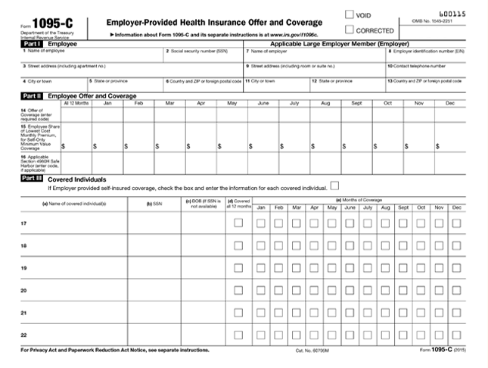
ACA Reporting - Updates
Under the Paperwork Burden Reduction Act, starting in 2025 employers generally only need to provide employees with a copy of Form 1095-C upon request.
  Employers must provide clear, conspicuous and accessible notice that anyone entitled to receive Form 1095-C can request a copy
  If requested, forms must be provided by January 31 (if requested in the prior year) or within 30 days
  1095-C forms must still be transmitted to the IRS

Slide 6
Kentucky Market Update
What are the option in Kentucky for 2026?
  Anthem
  United Healthcare
  Cigna/Aetna
  Partially Self-Funded Options
    Many different options to self-fund
  Anthem/KACo Association
  KEHP (State Plan)
KACo Benefits Group and bring ALL of these options !!

Slide 7

KEHP Plan
Increase of an average of 17.2% on Employee Coverage
Three plan are over $1,000 per month for single coverage
The fourth plan is $983.66 for single coverage
This increase is 100% mandated on the Employer
Plan changes to deductible, Max out of pocket, ER visits
Family Cross-Reference not available for employees hired on or after 1/1/2025
GLP-1 are covered but will be applied to deductible and co-insurance.

Slide 8


Air and Ground Transport

Slide 9
No Surpises Act
The NSA took effect for most relevant services on January 1, 2022.
When an out-of-network provider (including an air-ambulance provider) furnishes certain covered services (especially emergency services, or air-ambulance transports) where the patient cannot prudently choose a network provider, the law prohibits balance billing
Specifically for air-ambulance services: If the emergency transport is medically necessary and provided by an out-of-network air-ambulance provider, your cost share (deductible, coinsurance, copay) must be no greater than what you would pay if the transport was in-network.

Slide 10
No Surpises Act
The plan must count the employee’s cost-sharing (deductible/coinsurance) toward the in-network out-of-pocket maximum.
The plan/insurer and the air-ambulance provider will negotiate to determine what the insurer pays the provider. The employee is insulated from extra billing beyond their in-network cost share.
This does NOT apply to ground ambulance. There was a proposed bill in Kentucky to limit out-of-network costs for ground ambulance however it was not even heard in committee meetings.
When offering a service such as MASA, educate the employees on the associated risks before investing in a policy to cover Air/Ground transport services.

Slide 11

Tariffs on RX
Announced September 25, 2025, under the Trump Tariff Reform on Pharmaceuticals initiative.
Effective date October 1, 2025 — imposes a 100% tariff on branded and patented drugs imported into the U.S.
Exemptions:
  Manufacturers constructing U.S. production facilities (‘broken ground’ or ‘under construction’)
Pushing for “Most Favored Nation” pricing.
  The US should pay similar pricing as other similar countries.

Slide 12
Current Status of Implementation
(as of November 2025)
Although officially effective October 1, enforcement remains under review by the U.S. Trade Representative.
No confirmed public list of specific drugs subject to tariffs has been released.
Major manufacturers negotiating exemptions tied to new U.S. facilities.
Phased implementation expected in early 2026 once HTS codes are finalized.
Uncertainty remains around:
  Applicability to finished drugs vs. active ingredients (APIs)
  Definition of ‘Made in the USA’ verification.
Countries like the EU and Japan are seeking mutual trade deals to reduce or cap tariffs on pharmaceuticals, avoiding a trade war and preserving market access.

Slide 13
Impact on Group Health Plans
Short-term: Higher costs for imported branded/specialty drugs (oncology, autoimmune, diabetes).
Anticipated effects:
Rising 2026 pharmacy claims & specialty costs.
Formulary and prior authorization adjustments.
Increased stop-loss exposure in self-funded plans.
Outlook: Cost pressures through 2026, stabilization by late 2027.
Summary: Framework in place, enforcement incomplete.

Slide 14
What is TrumpRx.gov ?
TrumpRx is a federal government-backed initiative (via the administration of Donald Trump) to create an online portal where U.S. consumers can access prescription medications at discounted cash-pay prices, bypassing some of the traditional insurance/PBM system.
TrumpRx.gov would not itself dispense or ship medications; rather it acts as a “referral or portal” directing users to manufacturer direct-to-consumer (DTC) websites where the drug purchase happens.
of the key policy underpinnings: linking this portal to the broader strategy of applying “most-favored-nation” (MFN) pricing and leveraging trade/tariff threats on imported branded drugs to force lower price concessions by manufacturers. Investopedia+1

Slide 15
Plan Design Considerations
Waiting Periods | Term Rules | Accumulators
Options: 0, 30, 60 or 90 days Can’t exceed 90 days 1st of month following or immediately following | Options: Last day worked End of month | Options: Calendar Year Upon plan renewal
Note: Can’t change when the plan renews – July 1st

Slide 16
Thankyou !
Kelly Harding
Christina Heckathorn

