Slide 1


KACTFO Spring Conference
Auditor of Public Accounts

Slide 2
Introduction to the Auditor of Public Accounts (APA)
Constitutional Office
  The APA is an independent constitutional office responsible for auditing all state agencies, local governments, and other public entities.
Mission
  To act as a vigorous guardian of taxpayer dollars, providing the accountability, integrity, and leadership for Kentucky to thrive in the 21st century.
Auditor of Public Accounts

Slide 3
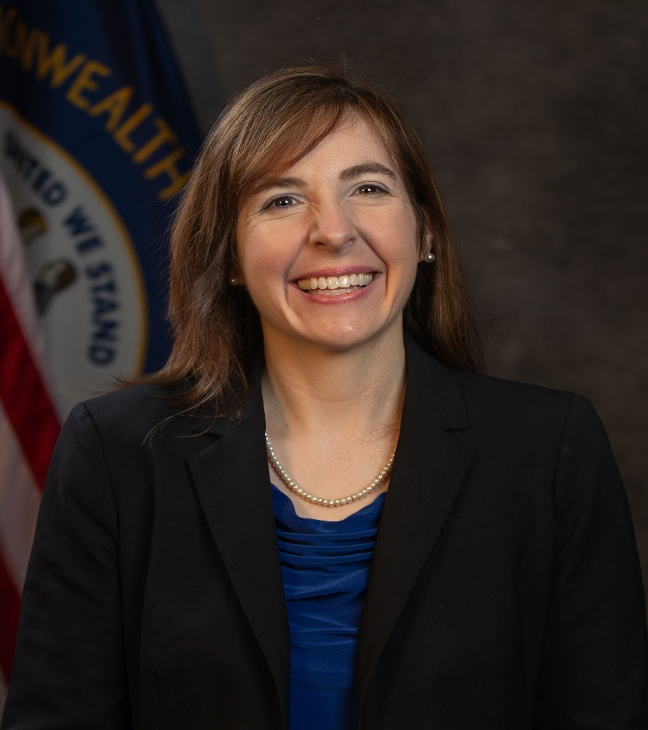
Allison Ball State Auditor
48th Auditor of Public Accounts
Former two-term State Treasurer
Watchdog of Kentucky taxpayer dollars
Notable Audits/Exams as Auditor include: Statewide Single Audit of Commonwealth, KY Dept. of Juvenile Justice, KY Dept. of Education, Medicaid Exam
Advocate for KY’s most vulnerable, including investigations into the treatment of foster children in state custody, kinship care funding, and more.
Auditor of Public Accounts

Slide 4
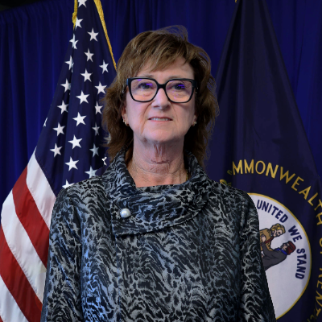
Shari Scott
Deputy State Auditor
Certified Public Accountant
Served at APA since 1997 as Financial Auditor and Audit Manager
Member of AICPA, KYCPA, NASACT, AGA
Auditor of Public Accounts

Slide 5
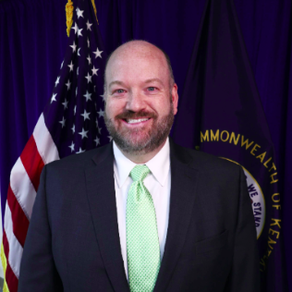
Jim Royse, Executive Director for the Office of Local Government Audits
Certified Fraud Examiner
Over 30 years of experience at the APA
Served as both Financial Auditor as well as Audit Manager
Auditor of Public Accounts

Slide 6

APA County Assignments
NEW BRANCHES – Updated from 4 to 6
Branch
Manager
Email
Phone
Branch A
Micah Blackwell
micah.blackwell@ky.gov
502-564-5841
Branch B
Cheryl Vaughn
cheryl.vaughn@ky.gov
502-209-2886
Branch C
Bradley Sergent
bradley.sergent@ky.gov
502-564-5841
Branch D
Bobby Bowling
bobby.bowling@ky.gov
502-209-2877
Branch E
Glen Thompson
glen.thompson@ky.gov
502-564-5841
Branch F
Joe Burkhart
joe.burkhart@ky.gov
502-209-2943

Slide 7
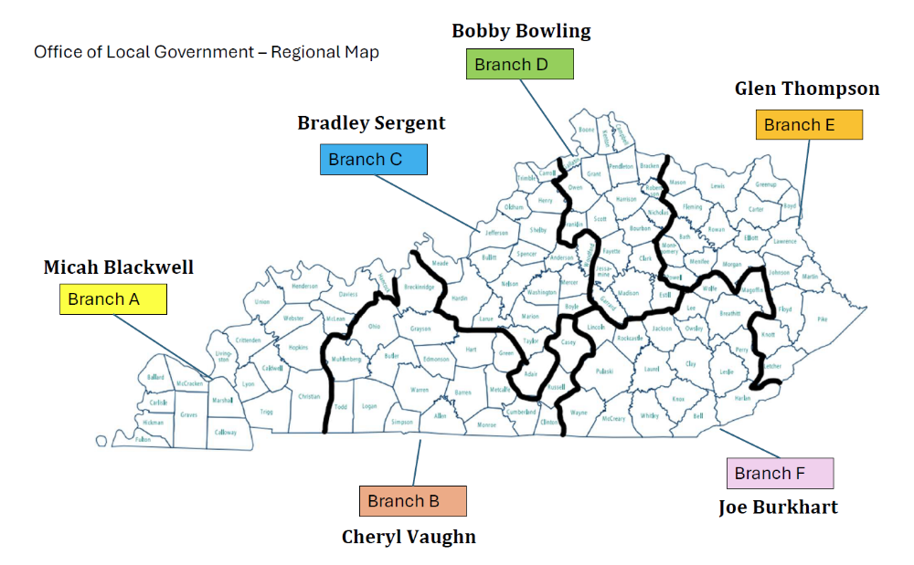
Auditor of Public Accounts

Slide 8
How to Have a Successful Audit
Auditor of Public Accounts

Slide 9
Why Do You Have An Annual Audit?
Required by KRS 43.070(1)(a)
  “The auditor shall audit annually the funds in the County Budget”
Auditor of Public Accounts

Slide 10
Who Performs The Audit?
Audits will be conducted by the Auditor of Public Accounts (APA).
Fiscal Courts can request an independent CPA firm, but APA must approve that request.
APA tries to audit Fiscal Courts once every four years.
Auditor of Public Accounts

Slide 11
What Does An Audit Tell Me?
The objective is to express an opinion on whether the financial statements are fairly presented, in all material respects.
Auditor of Public Accounts

Slide 12
How Is That Determined?
Audits are conducted in accordance with auditing standards generally accepted in the United States of America (U.S. GAAS).
Auditor of Public Accounts

Slide 13
Audit Standards
Auditing Standards & Audit Requirements set by:
  AICPA
  United States Government Accountability Office
  Federal Statutes – Uniform Guidance
Auditor of Public Accounts

Slide 14
Purpose of Audit Standards
Standards provide consistency in procedures used by all auditors to ensure the quality of each audit.
That means the reports produced by the APA meet the same standards as any other CPA firm in the United States.
Auditor of Public Accounts

Slide 15
Ten Steps to a Successful Audit
Auditor of Public Accounts

Slide 16
Ten Steps to a Successful Audit
Stay up-to-date on accounting standards, requirements, and statutes
Learn from the past
Plan ahead
Organize Records
Assess Changes in activities
Develop timeline and assign responsibility
Perform Self Review
Be available during fieldwork
Evaluate results
Ask Questions
SOI: www.aicpa.org
Auditor of Public Accounts

Slide 17
1. Stay up-to-date on accounting standards, regulatory requirements, and statutes
Who makes the rules:
  DLG: Uniform System of Accounts
  Kentucky General Assembly: Kentucky Revised Statutes (KRSs)
  Fiscal Court: Administrative Code, Personnel Polices, Ordinances
  OMB – Uniform Guidance for Federal Grants
  Governmental Accounting Standards Board (GASB)
  Others…
Auditor of Public Accounts
Notes:
Others: EPA (Landfill), SEC (Bonds), Rating Agency (S&P, Moodys)
As you see from the list one that is not on the list is the APA. We do not make the rules.

Slide 18
How to stay up to date?
Trainings and Associations
  KACTFO
  AGA(Association of Government Accountants)
Self Study
  Uniform Guidance
  Review new KRSs
Auditor of Public Accounts

Slide 19
Why is this Important?
Auditors audit based on the accounting standards, regulatory requirements, statutes, and county’s policies and procedures.
Auditor of Public Accounts

Slide 20
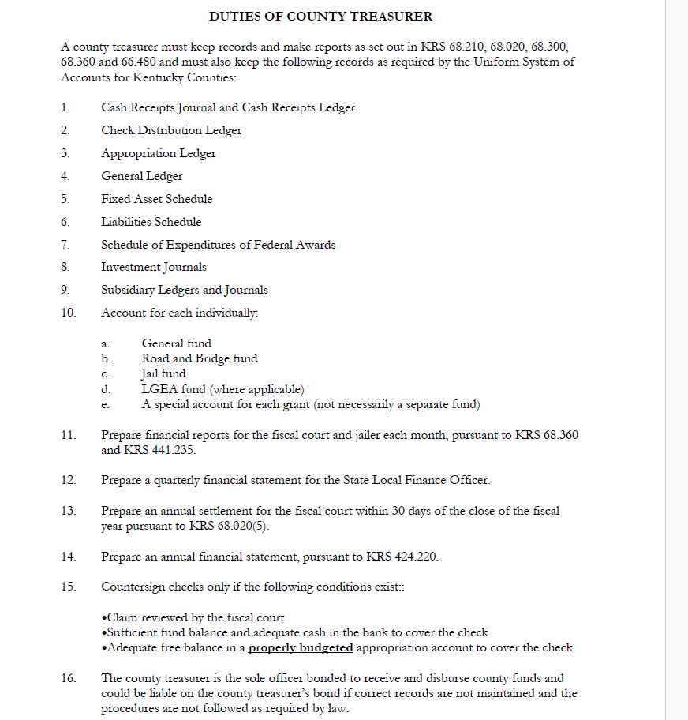
Auditor of Public Accounts
DLG Budget Manual - County Treasurer Duties

Slide 21
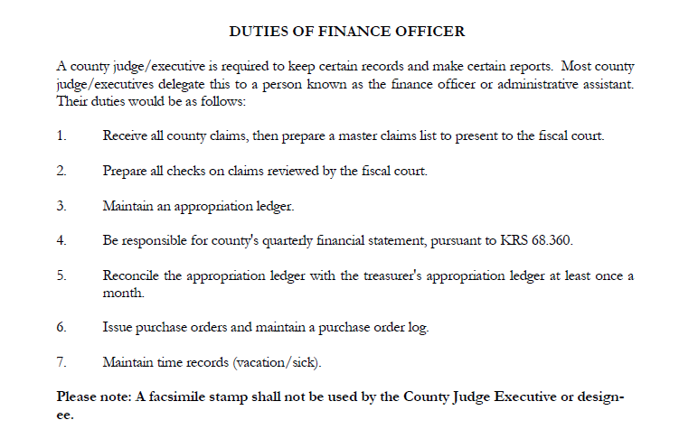
Auditor of Public Accounts
DLG Budget Manual - Finance Officer Duties

Slide 22
New Standards
GASB 103 - Financial Reporting Model Improvements
GASB 104 - Disclosure of Certain Capital Assets
Auditor of Public Accounts
Notes:
103 - The objective of this Statement is to improve key components of the financial reporting model to enhance its effectiveness in providing information that is essential for decision making and assessing a government’s accountability. This Statement also addresses certain application issues.
104This Statement requires certain types of capital assets to be disclosed separately in the capital assets note disclosures required by Statement 34. Lease assets recognized in accordance with Statement No. 87, Leases, and intangible right-to-use assets recognized in accordance with Statement No. 94, Public-Private and Public-Public Partnerships and Availability Payment Arrangements, should be disclosed separately by major class of underlying asset in the capital assets note disclosures. Subscription assets recognized in accordance with Statement No. 96, Subscription-Based Information Technology Arrangements, also should be separately disclosed. In addition, this Statement requires intangible assets other than those three types to be disclosed separately by major class

Slide 23
2. Learn from the past
  Prior Year Audit
  Update Administrative Code
  Monitor Internal Controls
Auditor of Public Accounts

Slide 24
3. Plan Ahead
Getting ready for an audit is not simply accumulating records before the auditor arrives. It starts before the fiscal year even begins
  Daily Responsibilities
  Monthly Responsibilities
  Quarterly Responsibilities
Auditor of Public Accounts
Notes:
Getting Budget Approved

Slide 25
Daily Responsibilities
Auditor of Public Accounts

Slide 26
Daily Receipts
Statutory Requirements
  68.020 County treasurer -- Duties and powers.
    (1) The county treasurer shall receive and receipt for all money due the county from its collecting officers or from any other person whose duty it is to pay money into the county treasury….
    (4)Shall keep an accurate detailed account of all money received and disbursed by him/her for the county, and shall keep books of accounts of the financial transactions of the county in the manner required by the uniform system of accounting prescribed by the state local finance officer
Auditor of Public Accounts

Slide 27
Daily Receipts
Receipt issued for all money received (KRS 64.840)
Receipts batched by type and attached to daily checkout sheet
Fill-out deposit ticket
Post to receipt ledger by receipt totals
Deposit into bank
Auditor of Public Accounts

Slide 28
Receipts
Receipts should document if funds were received by Cash, Check, or Credit Card
As noted by KRS, 3rd copy of the receipt should be batched and placed with the Daily Checkout sheet/daily deposit
Auditor of Public Accounts

Slide 29
Receipts – Daily Deposit
All public funds should be deposited into the official bank account on a daily basis
  KRS 68.210 requires county officials to make deposits, intact into a federally insured banking institution on a daily basis
Ensure Deposits are made Intact
  Intact: All monies received should be deposited as received–
    Payment made by Check – Check should be deposited
    Payment made by Cash – Cash should be deposited
    Do not cash personal checks –
      The make-up of the deposit should mirror the actual funds received for the daily business
Auditor of Public Accounts

Slide 30
Deposit funds intact on a daily basis and agree to daily records
Daily Records
  Batched Pre-numbered Receipt
  Forms
  Daily Check-out Sheet All Should Agree
  Daily Receipts Ledger Posting
  Daily Deposit
Auditor of Public Accounts

Slide 31
Receipts at Off-site Locations
Parks
Landfills
Recycling Center
Animal Shelter
Other Departments
Are they accounting for the receipts correctly and are you getting all funds collected?
Auditor of Public Accounts
Notes:
Road Department (Sale of surplus)

Slide 32
Disbursements
Statutory Requirements
  68.020 County treasurer -- Duties and powers.
  (1) The county treasurer…shall disburse such money in such manner and for such purpose as may be authorized by appropriate authority of the fiscal court. Shall not disburse any money received by him/her for any purpose other than that for which it was collected and paid over to him/her, and when he pays out money he/she shall take a receipt therefor. All warrants for the payment of funds from the county treasury shall be co-signed by the county treasurer and the county judge/executive.(County Judge can designate someone else to sign)
  (4)Shall keep an accurate detailed account of all money received and disbursed by him for the county, and shall keep books of accounts of the financial transactions of the county in the manner required by the uniform system of accounting prescribed by the state local finance officer
Auditor of Public Accounts

Slide 33
Disbursements
Review and approve disbursement
Submit claims to FC for their review
Write disbursement check
Record in disbursements ledger by disbursement category
Adequate Support
  Purchase Orders, Invoices, Agreements, Contracts, etc.…
Auditor of Public Accounts

Slide 34
Disbursements
Are they compliant with laws, regulations, policies and procedures
  KRS – Bidding, Within budget, Cosigned, FC review
  Admin. Code – County’s Procurement Polices and Procedures
    Purchase Order System, Awarding Contracts
Auditor of Public Accounts

Slide 35
Payroll
Employee works and maintains timesheet
Supervisor reviews and approves timesheet
Review wage calculation, OT calculation, all deductions, leave time used or accumulated and process payroll check
Update leave balances per employee for pay period
Remit withholdings to appropriate entity
Post to disbursement ledger
Pay employees
Auditor of Public Accounts

Slide 36
Time Records
The Fair Labor Standards Act requires that hours worked each day and total hours worked each work-week should be disclosed.
Time records should be signed by both the employee and supervisor.
Time records should be reconciled to “leave balances” (sick, comp, and annual leave).
Auditor of Public Accounts

Slide 37
Payroll
  Policies should agree to office practice:
    Actual everyday practice should be in compliance with written policies for –
      Accumulation and Use of Leave/Comp Time
Policies should adhere to laws and regulations for Wage and Hour
Overtime Pay
Time and Payroll records for time worked
Auditor of Public Accounts

Slide 38
Monthly Responsibilities
Auditor of Public Accounts

Slide 39
Bank Reconciliations
Obtain bank statements
Compare receipts and disbursements cleared to ledgers
Document and keep documentation of reconciliation
Auditor of Public Accounts
Notes:
Purpose is to compare books to bank balance

Slide 40
Bank Account Records and Reconciliations
Keep all bank statements and have them ready for the auditor.
Prepare a listing of all bank accounts.
Reconcile ledgers with bank records.
Cash reported on the financial statements should agree to your reconciliations.
If you have any discrepancies between the bank and your records, investigate immediately. Don’t let it go!
Auditor of Public Accounts

Slide 41
Bank Account Records and Reconciliations
Close out old bank accounts.
Payroll revolving account balance should be minimal.
Document reconciliation process/controls.
Who has Signature Authority?
Auditor of Public Accounts

Slide 42
Treasurer’s Monthly Report
KRS 68.360 - Treasurer is required to present a monthly statement to FC that contains –
  List of warrants paid during the month
  All cash receipts and the cash balance at the beginning and the end of the month
  Certify that each warrant or contract is within the budget appropriation.
Auditor of Public Accounts

Slide 43
Quarterly Responsibilities
Auditor of Public Accounts

Slide 44
Quarterly Financial Report
Complete quarterly financial report
  Budget amounts agree to approved budget
  Budget amendments agree to amount/accounts approved by FC and State Local Finance Officer
  Transfers agree to amounts/funds FC approved
  Agrees to receipts and disbursements ledgers
Due to DLG no later than 20th of the month following close of quarters ending September 30, December 31, March 31, and June 30
Note – Quarterly report has a bank reconciliation on first page
Auditor of Public Accounts

Slide 45
Quarterly Report Submission Statute
KRS 68.360(2) – The county judge shall, within 15 days after the end of each quarter prepare a statement showing for the current fiscal year to date actual receipts from each county revenue source, the totals of all encumbrances and expenditures charged against each budget fund, the unencumbered balance of the fund, and any transfers made to or from the fund.
Auditor of Public Accounts

Slide 46
How do you ensure the 4th quarter report is correct?
Starts with Keeping Accurate Records Every Day:
Daily Receipt Records
    Pre-numbered Receipt Forms
    Daily Check-out Sheet All Should Agree
    Daily Receipts Ledger Posting
    Daily Deposit
Daily Expenditure Records
  Invoice
  Check All Should Agree
  Daily Disbursement Ledger Positing
Auditor of Public Accounts

Slide 47
Ensure records agree to the 4th quarter report
  Ledgers (Receipts and Disbursements)
    Ledger Categories Should Match the Categories/Accounts per Quarterly Report
    Should be Posted to Daily and Agree to Daily Records
    Should be Totaled Monthly/Quarterly/Yearly
    Should Agree to Quarterly Reports and Final Settlement
    Submit Quarterly Reports to DLG as Required
  Bank Reconciliations
    Completed Monthly and Reconciled to Ledgers
Auditor of Public Accounts

Slide 48
4. Organize Records
  Each engagement letter sent by APA has a list attached requesting certain records be ready when the auditor arrives
  Good idea to use the PY list to start accumulating and organizing records throughout the year
Auditor of Public Accounts

Slide 49
Get Prepared – What We’ll Ask For
Fiscal Court Minutes/Orders
Approved Original Budget and Approved Amendments
Treasurer’s Settlement
Receipts Ledger
Disbursements Ledger
Auditor of Public Accounts

Slide 50
Get Prepared – What We’ll Ask For
Fourth Quarter Financial Statement
Bank Reconciliations
List of All Bank Accounts
Collateral Security Agreements
Investments Journal or Schedule of Investments
Auditor of Public Accounts

Slide 51
Get Prepared – What We’ll Ask For
Capital Asset Listing and Insurance Statement of Values
Debt Agreements
Purchasing Records / Bid Files
Grant Agreements
Copy of FC’s Administrative Code
Auditor of Public Accounts

Slide 52
Backup Your System
Backing up your financial records is crucial because they protect your financial data from loss due to errors, system failures, or unexpected events.
There are several practical ways to back up financial data:
  External hard drives or USB backups provide a physical copy you control and can store securely.
  Accounting software backups let you save snapshots of your data at regular intervals.
Scheduling automatic backups ensures it is done and nothing is lost.
Auditor of Public Accounts

Slide 53
5. Assess Changes in Activities
  Federal Grants
    Reporting Requirements, Compliance Requirements
  New taxes
  New Programs
  Changes in internal controls
Auditor of Public Accounts

Slide 54
Schedule of Expenditures of Federal Awards (SEFA)
You MUST submit a SEFA to DLG with 4th Quarter Report
SEFA is part of your annual financial statement
Used to determine if you need an audit of federal awards (single audit)
Auditor of Public Accounts

Slide 55
Schedule of Expenditures of Federal Awards (SEFA) – Information Included
Federal Grantor
Pass-Thru Agency
Program or Cluster Title
Federal ALN Number
Pass Through Entity’s Identifying Number
Amount Provided to Subrecipients
Amount Expended
Auditor of Public Accounts

Slide 56
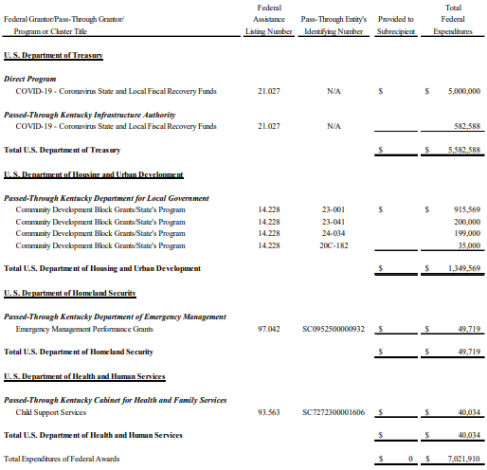
Excel file can be found on DLG Website
Auditor of Public Accounts

Slide 57
When do you need a single audit?
New Threshold: The threshold for a single audit is $1 million in federal funds expended, effective for fiscal years starting on or after October 1, 2024
Prior Fiscal Years - $750,000
Auditor of Public Accounts

Slide 58
6. Develop timeline and assign responsibility
  Review list of records and items needed for audit
    Who is responsible to compile these records
    Tackle the most difficult, complex, or time-consuming areas first so items will be available when the auditor arrives
    Notify others in the county that the auditors will be coming
      Jailer, Finance Officer, Occupational Tax Director, etc…
Auditor of Public Accounts

Slide 59
7. Perform Self Review
  Is your financial statement ready for an Audit?
Auditor of Public Accounts

Slide 60
Financial Statement Tips
Make sure the information is CORRECT
  Agrees to Ledgers and ending reconciled cash balance
Mathematically Accurate
Reported Budget amounts agree to Original Budget and Approved Amendments
Auditor of Public Accounts

Slide 61
Financial Statement Tips
All Cash Transfers between funds are approved by FC and recorded
All Budget Appropriation Transfers are included and agree
Includes All Debt of County, Including PPC Debts
Don’t Overspend Budgets
Auditor of Public Accounts

Slide 62
Why Do The Financial Statement Tips Matter?
Your Fourth Quarter Report is the financial statement being audited.
Errors = Audit Findings
Auditor of Public Accounts

Slide 63
Errors Seen on Quarterly Reports
Does not agree to the Final Budget
Debt Not Accurately Reported
Cash Balances per Summary do not agree to Bank Reconciliations
Beginning balance does not agree to prior year ending balance
Auditor of Public Accounts

Slide 64
Example: Final Budget Does Not Agree to Quarterly Report
Recapped Budget and Budget Amendments for the General Fund did not agree to the 4th Quarterly Report’s total General Fund Budget.
Auditor of Public Accounts

Slide 65
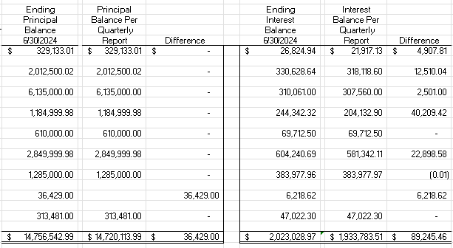
Debt Not Accurately Reported on Quarterly Report
A new debt was not added to the debt section of the quarterly and the interest amounts were not up to date.
Auditor of Public Accounts

Slide 66
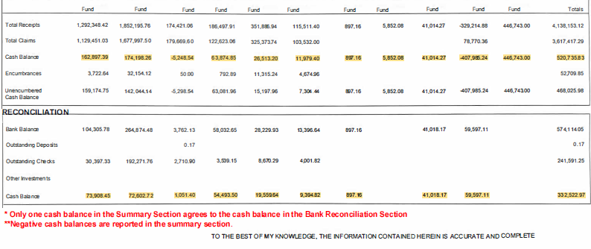
Cash Balances Do Not Agree and Some Reflect Negative Balances
** - Negative Cash Balances
* - Only One that Agrees
Auditor of Public Accounts

Slide 67
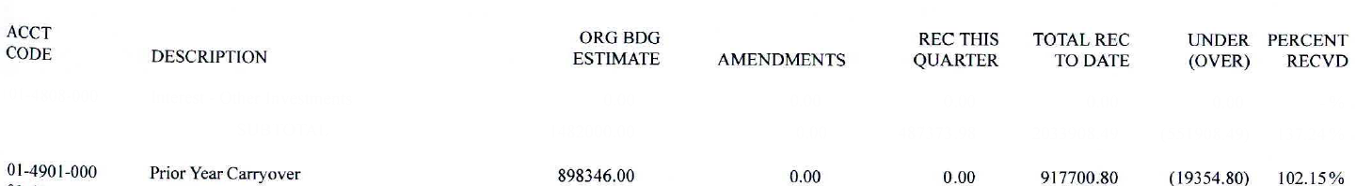
Prior Year Ending Balance Does Not Agree to Beginning Balance
From Prior Year Audit -
Variance of $568,592
Auditor of Public Accounts

Slide 68
8. Be Available During Fieldwork
  Engagement Letter – Will be signed by Judge/Executive
Auditor of Public Accounts

Slide 69
Get Prepared – First Things First
Auditor will contact you in advance to schedule when we will be on-site.
Auditors will need a place to work, access to Wi-Fi (if available)
Auditor of Public Accounts

Slide 70
Get Prepared – Entrance Conference
Set aside time on the first day for entrance conference
Discussion of Prior Year Findings
Alert your auditor of any significant changes or issues
Auditor of Public Accounts

Slide 71
9. Evaluate Results
  Wrapping Up An Audit
  Auditors will schedule an Exit Conference with you to communicate findings and provide a manner for officials to respond.
  Officials will be given ten (10) days to respond to findings.
  Official responses will be provided to auditors in writing.
Auditor of Public Accounts

Slide 72
Any Changes?
What Changes need to be made?
  Internal Controls
  Admin code
  Policies and Procedures
Auditor of Public Accounts

Slide 73
10. Ask Questions
Be Involved in Audit Process
  Take initiative to understand your responsibilities during the audit
Exit Conference
  Make the most out of the exit process – ask questions about audit findings
  Review findings and develop a plan to correct
Auditor of Public Accounts

Slide 74

Questions
.
Auditor of Public Accounts

