Slide 1
DEPARTMENT OF RURAL AND MUNICIPAL AID
KENTUCKY ASSOCIATION OF COUNTIES
“DRMA: FUNDING UPDATES”
MARCH 26, 2026

Slide 2
Current Fiscal Year (FY 26): (Road Aid)
COUNTY ROAD AID - $115,484,230
MUNICIPAL ROAD AID - $36,647,312 Coop ($11,944,383 – sent to DLG for non-Coop)
Current Fiscal Year (FY 2026) – Other Funding Sources
RURAL SECONDARY FUNDS - $82,156,612
FLEX FUNDS- $26,163,587
80/20 BRIDGE & STATE EMERGENCIES - $9,819,217
COUNTY ROAD AID EMERGENCY FUNDS - $2,887,591
MUNICIPAL ROAD AID EMERGENCY - $201,297

Slide 3
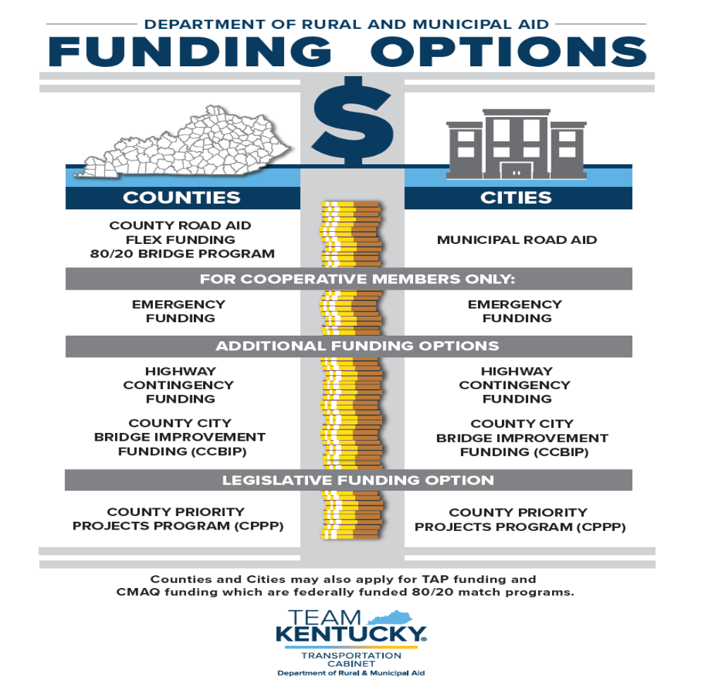

Slide 4

FUNDING PROGRAMS ADMINISTERED BY DRMA’S OFFICE OF RURAL AND SECONDARY ROADS
I. COOPERATIVE ROAD AID PROGRAM
II.
FLEX FUND PROGRAM
III.
80/20 BRIDGE PROGRAM
IV. EMERGENCY FUNDING PROGRAM

Slide 5

REVENUE SHARE BREAKDOWN
RURAL SECONDARY ALLOTMENT
KRS 177.320
22.2% of motor fuel tax
Allocations established by Fifths Formula
3% allocated for administrative costs
Up to 6% allocated for RS emergency account
COUNTY ROAD AID ALLOTMENT
KRS 177.320
18.3% of the motor fuel tax for county roads
Allocations to counties established by Fifths Formula
Used for construction, reconstruction and the maintenance of county roads
3% allocated to the county emergency account
MUNICIPAL ROAD AID ALLOTMENT
KRS 177.36 & 177.366
7.7% of the motor fuel tax for urban roads and streets
Allotment per city determined by population
Used for construction, reconstruction and maintenance of city streets
3% allocated to the municipal emergency account

Slide 6

COUNTY AND MUNICIPAL ROAD AID PROGRAM
Road Aid funds are allocated annually for construction and maintenance of your roads.
There are two ways to receive Road Aid funds:
Monthly through the Kentucky Department for Local Government (DLG), OR
Join the ORSR Cooperative Program
***Agreements are sent out at the end of March and should be sent back ASAP
IF YOU JOIN THE ORSR COOPERATIVE PROGRAM YOU WILL BE ELIGIBLE FOR EMERGENCY FUNDING

Slide 7
COUNTY AND MUNICIPAL ROAD AID PROGRAM
- Road Aid funds are allocated annually for construction and maintenance of your roads.
- These funds are distributed three times per year. The first at the end of August, second at the end of January, and third at the end of the year. The first two are estimated payments and the third is the “make whole” payment.
The first and second payments have been made.
For your awareness:
80/20, FLEX, and Emergency funding sources are fully functional and available for use.

Slide 8
County (“CRA”) & Municipal (“MRA”) Road Aid Payments
Why the February Road Aid Payment was less than anticipated
August Payment (60%): was based on HB 265’s estimated allocation of $157,306,800 (“CRA”) and $66,189,200 (“MRA”).
In December, the Consensus Forecasting Group (“CFG”), reduced the estimate to $135,863,800 (“CRA”) and $57,166,700 (“MRA”).
KRS 177.360(4) requires payments to be adjusted when revenue estimates change.
February Payment (25%): based on the December CFG estimate of $135,863,800, totaled $29,126,235 (“CRA”) and $8,878,175 (“MRA”).

Slide 9
County (“CRA”) & Municipal (“MRA”) Road Aid Payments
What Local Officials should expect
Final payment will be 15% in July, 2026.
Payment will be based on ACTUAL FY26 Road fund receipts.
Ensures each county and city receives its correct legal share according to the Fifths Formula.

Slide 10
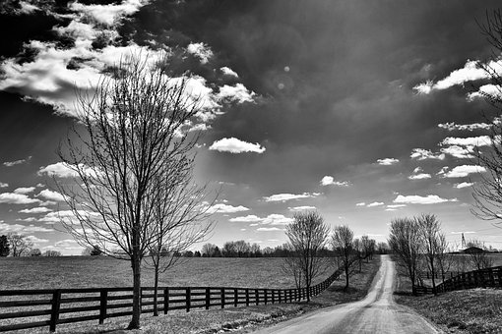

THE FLEX FUND
Funds allocated to counties for resurfacing

Slide 11
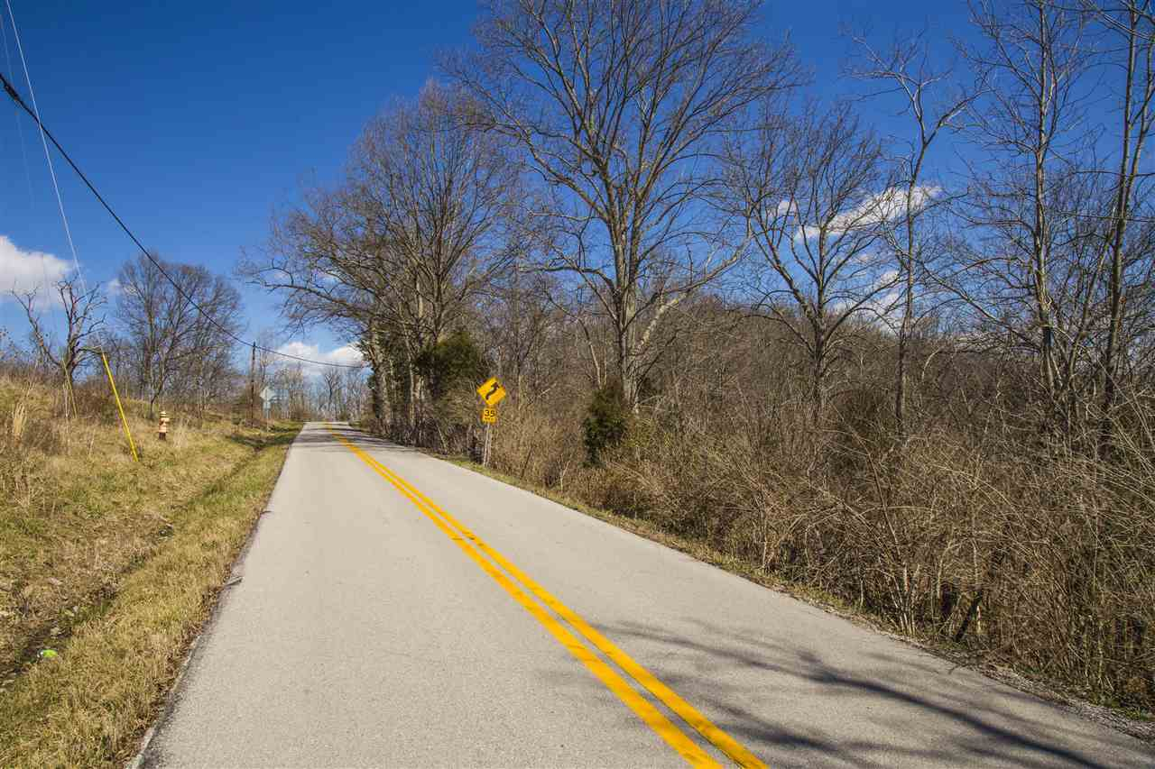
The Flex Funds
FY 26 PROJECTION: $27,138,552
What are Flex Funds?
These are funds set aside from the Rural Secondary (22.2%) apportionment to help counties in their resurfacing needs.
These funds are to be solely used for repairs and resurfacing the existing asphalt surface.
With over 40,000 county road miles we recognize the need for assistance!
District personnel will communicate with each county as to the amount of Flex Funds the county will be allocated for the upcoming fiscal year

Slide 12
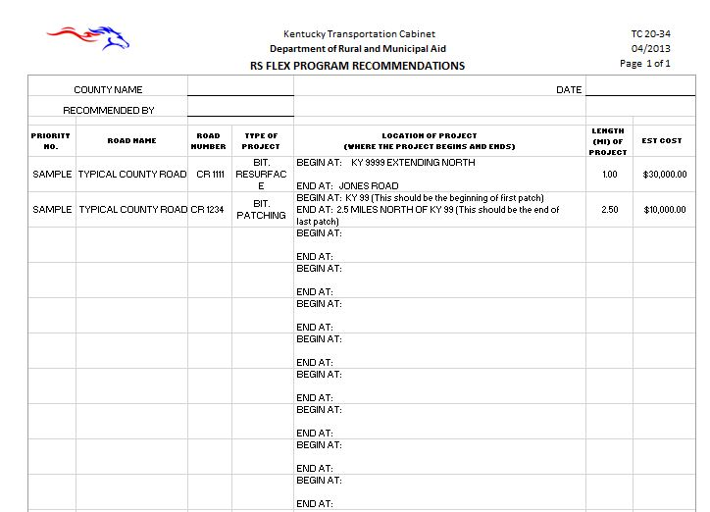
HOW TO APPLY FOR COUNTY ‘FLEX’ FUNDING CONSIDERATION
To receive funding counties must complete the TC 20-34 and submit to the Office of Rural and Secondary Roads for evaluation and determination of eligibility.
Submit this request electronically to: RuralandMunicipalAid@ky.gov

Slide 13
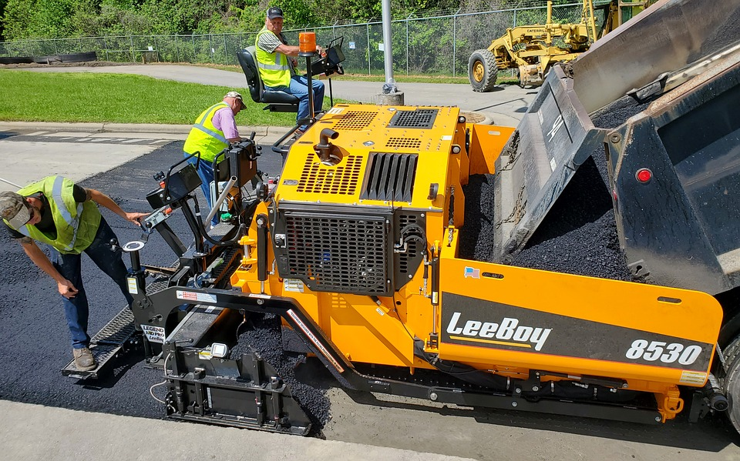
Flex Fund
To Determine the allocation of Flex Funds to each County the State’s Division of Maintenance reviews the rural secondary roads in each county and determines the necessary funding needed for the reasonable up-keep of these roads during that fiscal year.
Features used in determining the rating
Rideability Appearance Vertical Clearance Guardrail Specifications Guardrail Damage | Visual Obstructions Fencing Attenuators Potholes Rutting | Pavement Drop Off Drains Ditches Curb and Gutter White Stripe Yellow Stripe | Guide Signs Guide Sign Assemblies Warning and Reg. Signs Warning and Reg. Sign Assemblies

Slide 14
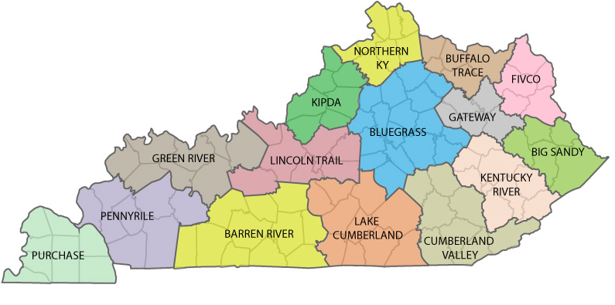
Adopting County Roads
  How to get credit for the road miles?
    Contact and work with your local Area Development District (ADD)
    ADD Districts work with our Division of Planning to register the roads
    If you are using our mapping system and cannot find your road please contact us!

Slide 15
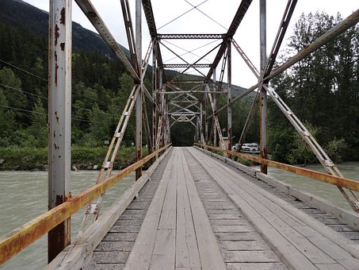
The RS 80/20 Bridge Program
Funds allocated for drainage structure maintenance

Slide 16
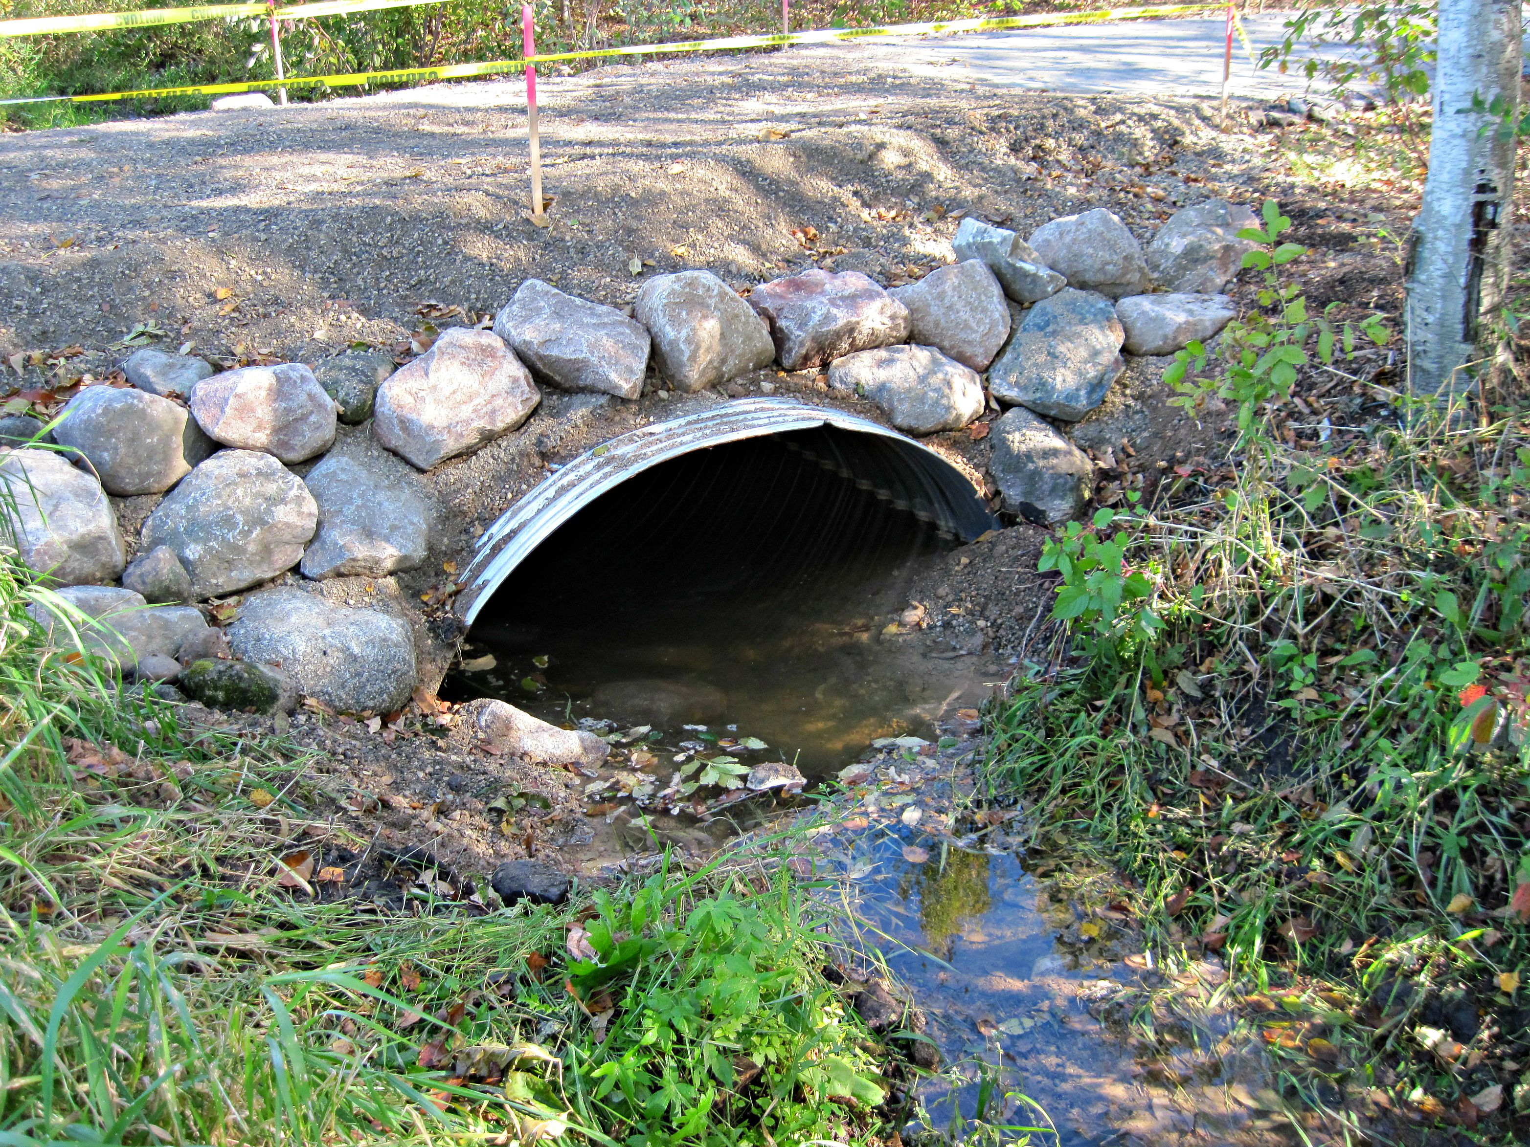
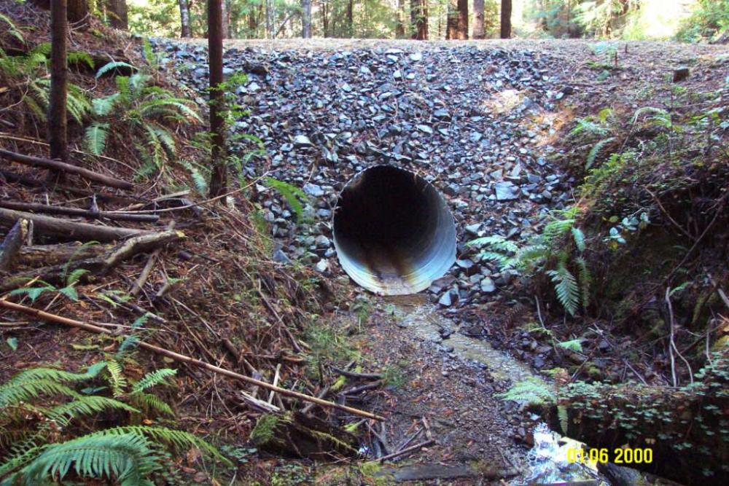
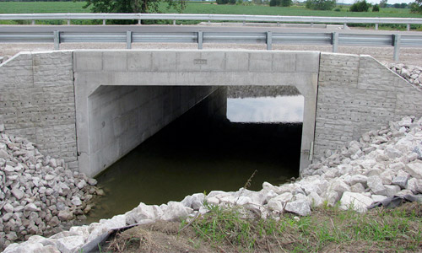
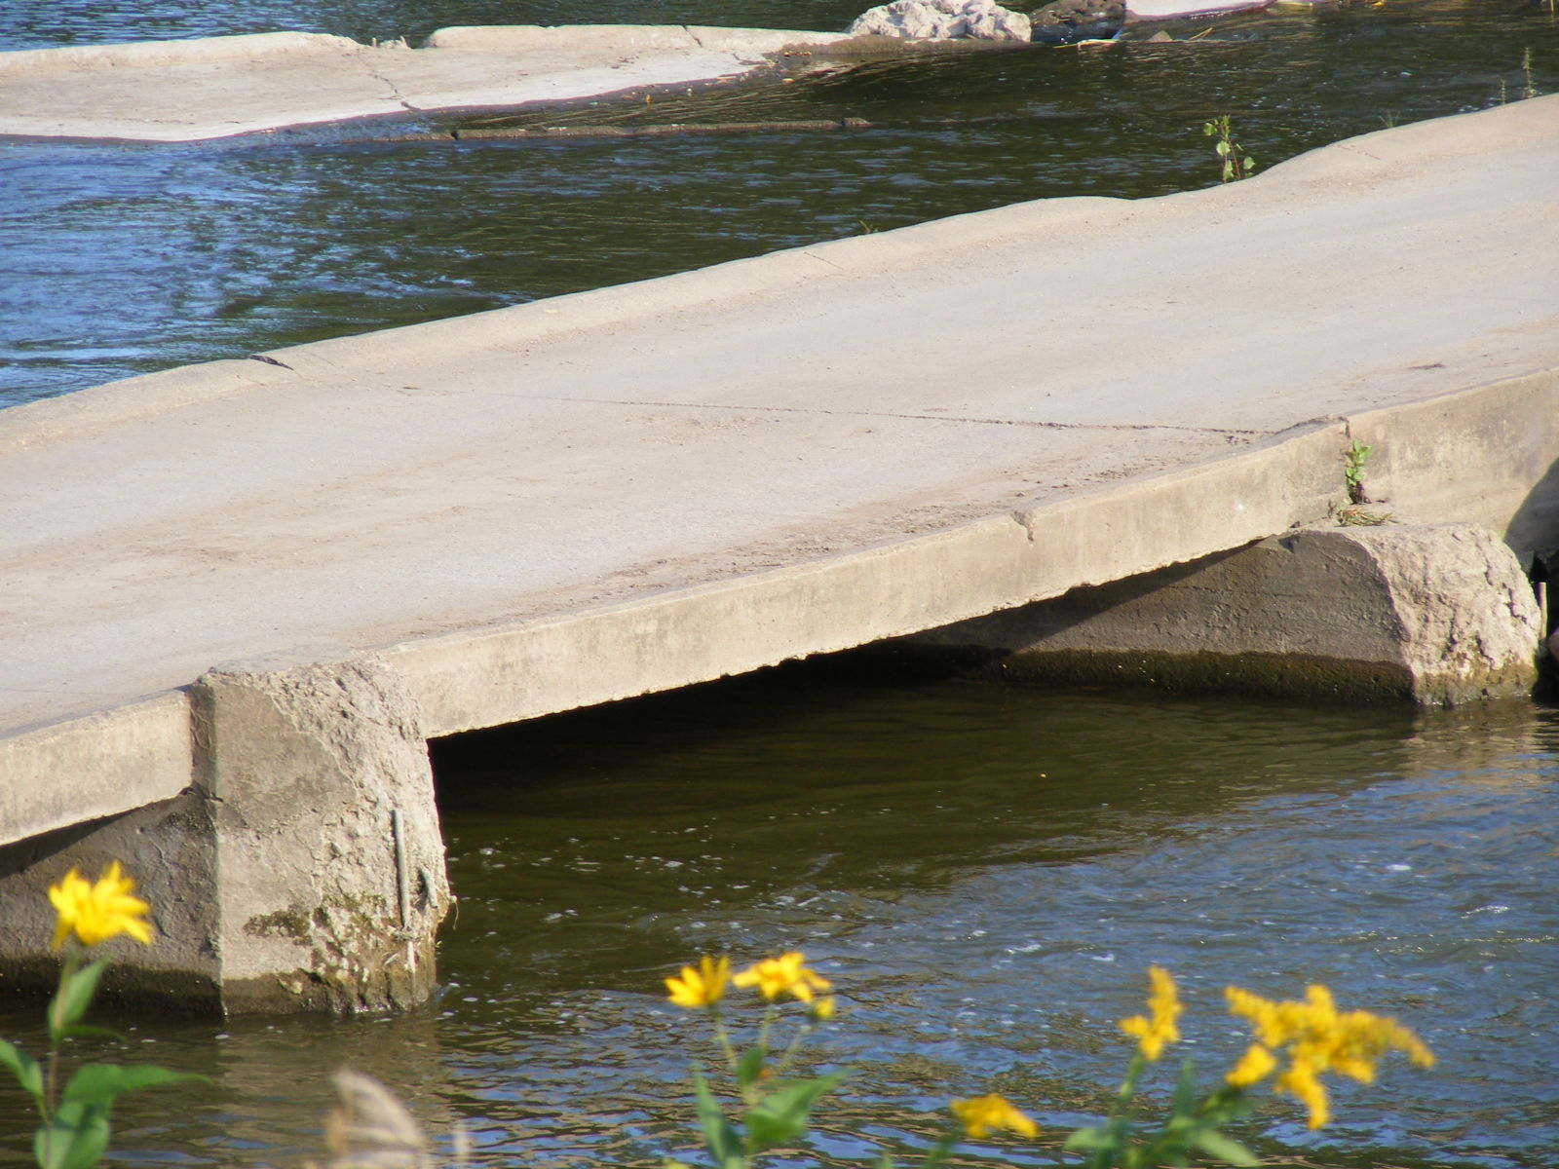
RS 80/20 Bridge Program
The 80/20 Bridge Program is funding set aside from the RS emergency fund to be used for repair or replacement of existing drainage structures, bridges, low water fords, culverts, pipes, etc. on county roads. The Office of Rural & Secondary Roads (ORSR) determines the allotment percentage each year based on gas tax receipts. At this time, each county receives up to $80,000 per fiscal year, with no carry forward.

Slide 17
RS 80/20 Bridge
The KYTC Division of Structural Design has created “bridge” drawings at no cost to the counties and are available for use:
  Pile End Bents
  Abutment Plans
  Steel Superstructure Plans
  2-Railing Alternatives
  Existing Box Beams
  Final Standard Steel Composite
  Culverts
  Piers 22X36
  Associated Deck Unit Standard Drawlings ( for use with the above listed)
These can be found on our website! www.Transportation.ky.gov - Rural and Municipal Aid

Slide 18
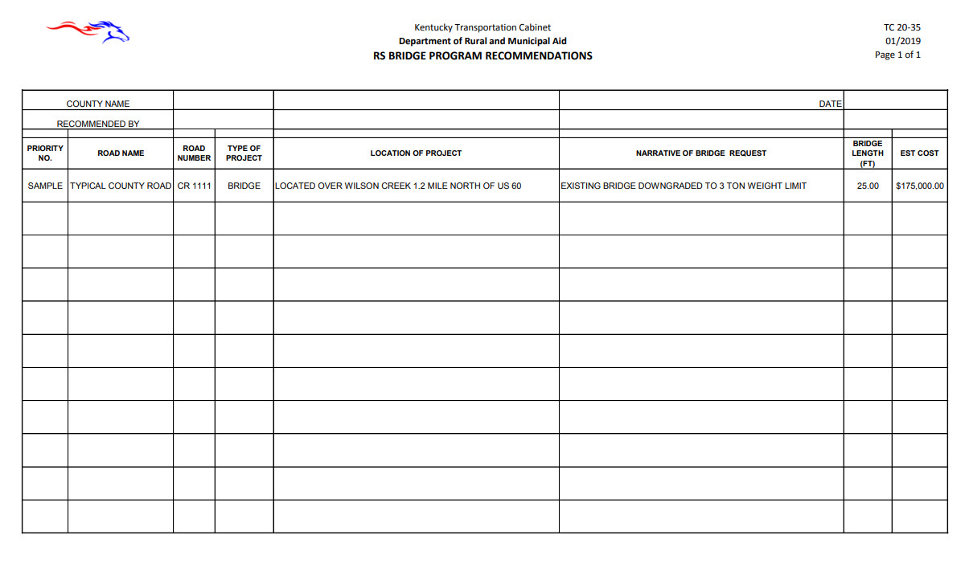
RS 80/20 Bridge Request TC 20-35
This form should be submitted electronically to: RuralandMunipalAid@ky.gov

Slide 19
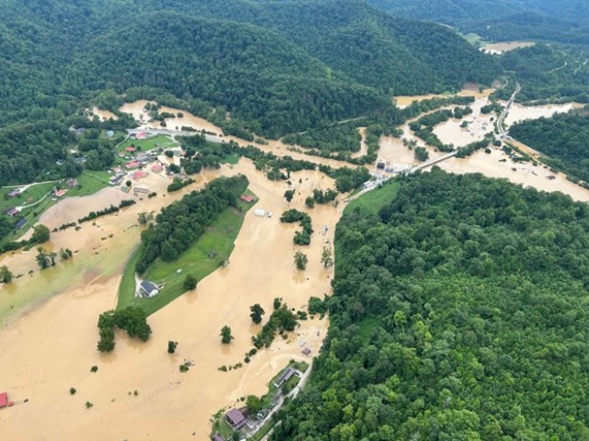
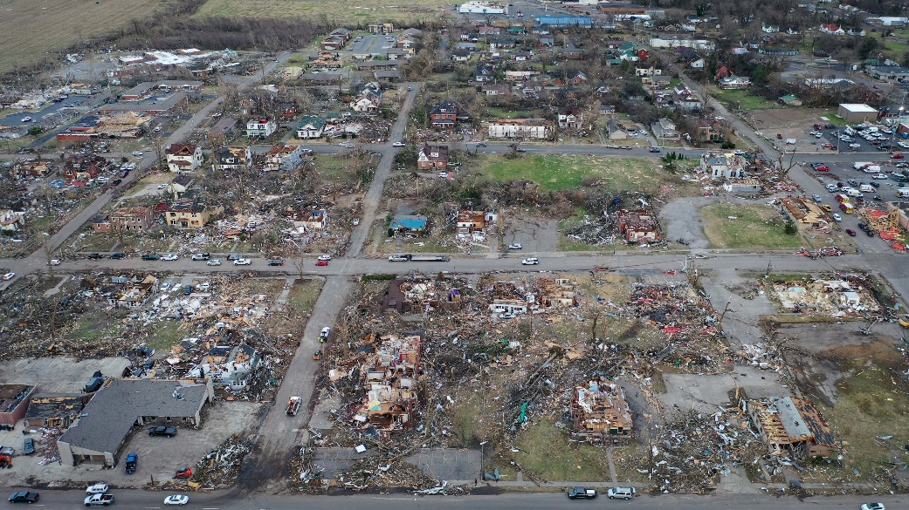
The Emergency Fund

Slide 20
EMERGENCY PROCESS: TC 20-16
Initial Project Cost: | $100,000
Approved 80% | $80,000
50% of Approved amount issued immediately: | $40,000
Receipt’s Submitted New Project Cost | $75,000
80% of actual cost: | $60,000
-50% previously issued: | $40,000
Reimbursement | $20,000
Application Guidelines:
Requires application form (TC 20-16)
Because this is an emergency, you may begin work at anytime. However, it is possible that a project may not be approved for funding.
When a request is approved, notification is sent to the local government and 50% of the approved funding is released immediately. The remaining amount is released after the final project cost has been tabulated (invoices, etc.)
Project examples: bridge replacement, slide repair, flood damage, etc.

Slide 21
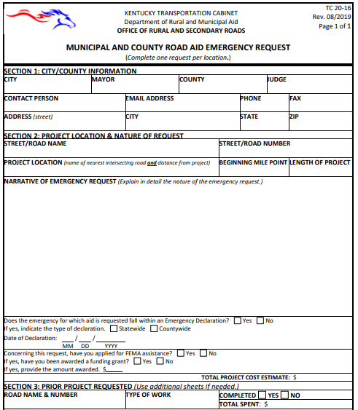
EMERGENCY REQUEST:
TC 20-16
Submit along with:
Pictures
Detailed cost estimate
You can submit drainage structures under this program if your project meets the following:
  Closed structure
  Posting load lowered and no longer allows school buses or first responders to cross
  One way in or out

Slide 22
LOCAL ASSISTANCE ROAD PROGRAM
LOCAL ASSISTANCE ROAD PROGRAM (“LARP”)
a/k/a County Priority Projects Program (“CPPP”)
OVERVIEW OF FY 26-27
APPLICATION CYCLE

Slide 23
LOCAL ASSISTANCE ROAD PROGRAM
Modified requirements and guidelines for the CPPP/LARP Program set out in 25RS HB 546 (codified in KRS 176.243):
Limited to rehabilitation projects bringing road or street back to original condition.
Allowed maximum of $500,000 in funding per project.
Required one photograph for every 300 feet of the project.
Required development and use of new scoring matrix.
Required local match
BREAKING NEWS:
Chip/Seal roads may be submitted during the upcoming cycle and considered for funding. They must be rehabilitated to the original chip/seal condition.
Keep on eye on Legislative activity during the present session for any modifications to the parameters of the program.

Slide 24
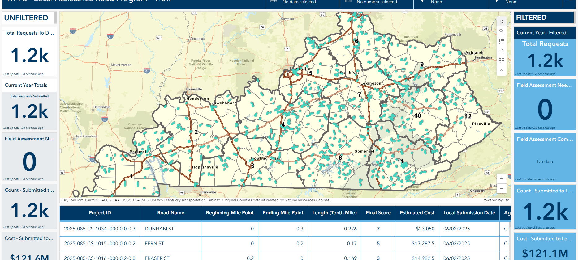

Slide 25
LOCAL ASSISTANCE ROAD PROGRAM
FY 26-27 APPLICATION CYCLE SUMMARY
The FY 26-27 Application Cycle began on June 1, 2025, ended on October 1, 2025, and resulted in the following:
Total Projects Submitted: 1223
Total Project Cost Submitted: $121,329,654.51
Total Amount Requested (after match): $102, 433,041.55
# of Counties Applied (116 represented): 108
# of Cities Applied: 106
Total length of road mileage: 1059.3 miles
-

Slide 26
LOCAL ASSISTANCE ROAD PROGRAM
FY 26-27 APPLICATION CYCLE SUMMARY
Average Project Cost Submitted: $99,206.59
Average Amount Requested (after match): $83,755.55
Total Funding for 8’s, 9’s and 10’s: $ 82,294,815.30
PROJECT RANKINGS:
10’s: $36,322,401.11 30%
9’s: $26,453,163.31 22%
8’s: $19,519,260.88 16%
7’s: $14,552,782.54 12%
6’s: $ 9,931,650.81 8%
5’s or < $14,550,405.73 12%
-

Slide 27
LEGISLATION PENDING
House Joint Resolution (“HJR”) 76 filed 3/3/2026 -
Lists projects for the Local Assistance Road Program (“LARP”) - Totaling: $68,130,000.00
Remember: HJR 76 must go through committee, and the House and Senate approvals before it is final.
https://apps.legislature.ky.gov/record/26rs/budget/HJ76/orig_bill.pdf.pdf

Slide 28
FUNDING PROGRAMS ADMINISTERED BY
THE DEPARTMENT OF RURAL AND MUNICIPAL AID (“DRMA”)
I. HIGHWAY CONTINGENCY FUNDING
III. COUNTY CITY BRIDGE IMPROVEMENT PROGRAM “CCBIP”

Slide 29
HIGHWAY CONTINGENCY FUNDING – FD-39
Funding for FY 26 is $5 million and is limited to hazardous & emergency conditions ONLY.
Application process will begin July 1, 2025, and will be available throughout fiscal year 2026.
Apply with Form TC 20-42 contained in the KYTC/DRMA Forms Library.
Applications should be made to Department of Rural and Municipal Aid by email to: bobbijo.lewis@ky.gov, debra.Powell@ky.gov and/or your Governmental Field Service Representative.
Please send estimate and photo with application.
FORMTC 20-42

Slide 30
COUNTY/CITY BRIDGE IMPROVEMENT PROGRAM UPDATE (“CCBIP”)
FY 2025 & FY 2026 - $25 million authorized for each year
Awarded:
- FY 2025: Phase I, II, and III:
i. 58 Bridges funded: 40 replacement projects &
18 repair/preservation projects
ii. Total funding authorized in FY 2025 - $24,988,014
  - FY 2026: Phase IV, V, & VI:
i. 39 Bridges funded: 31 replacement projects &
            8 repair/preservation projects
ii. Total funding authorized - $20,201,692.40
  TOTAL FUNDING REMAINING: $4,810,293.60
-

Slide 31
CCBIP APPLICATION CYCLE
HELPFUL HINTS
Apply with Form TC 20-44 contained in the KYTC/DRMA Forms Library.
Email applications to bobbijo.lewis@ky.gov, greg.meredith@ky.gov and/or your Field Representative.
Local Bridges Webinar completion is required before award. You may register at https://kyt2.uky.edu/training/ccbip. No Cost to Participate!
This is a construction reimbursement program. Engineering fees and application development fees are not reimbursable expenses. These fees are considered local contribution toward the projects.
Standard Drawings are available for use and contained on KYTC’s website.

Slide 32
COUNTY CITY BRIDGE IMPROVEMENT PROGRAM “CCBIP”
PHASED APPROACH FOR APPLICATION SUBMISSION
KYTC’s Department of Rural and Municipal Aid (“DRMA”) is currently accepting County/City Bridge Improvement Program applications (TC 20-44) to address bridges that are closed or have posted traffic limitations.
FY 2026 APPLICATION CYCLE DATES - $25 MILLION AUTHORIZED
Phase 7: Begins February 16, 2026 – closes May 1, 2026
In planning for a bridge replacement or repair project, your first step should be to
contact your Chief District Engineer’s Office in your Transportation District to assist
you in confirming inspection findings involving your bridge, discussing corrective actions,
and providing necessary recommendations to correct deficiencies.
DRMA looks forward to working with you to improve bridge structures across Kentucky. Please reach out with questions or requests for assistance to:
Bobbi Jo Lewis, Commissioner, (502) 892-9022, bobbijo.lewis@ky.gov
Greg Meredith, Executive Advisor, (270) 495-7291 , greg.meredith@ky.gov

Slide 33
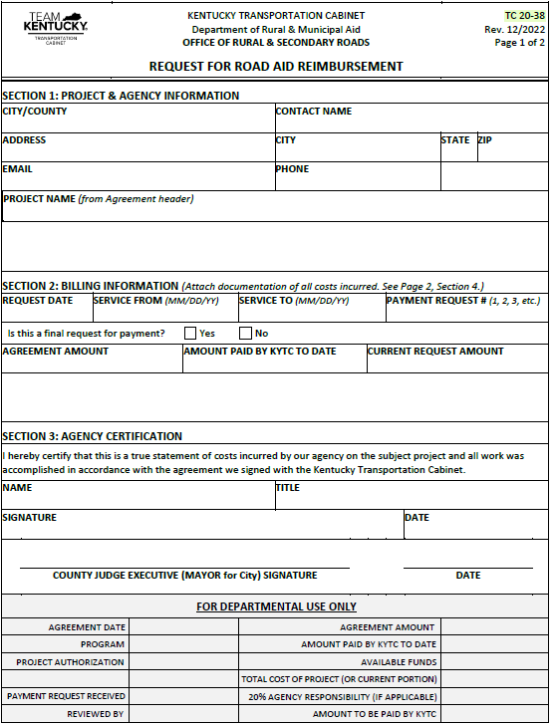
Reimbursement
Keep detailed records as the work is done.
Follow the guidelines we send the county when the project is approved.
Submit Form TC 20-38 and supporting documentation to RuralandMunicipalAid@ky.gov.
Contact Kelley Johnson for Rural/Secondary questions and your Chief District Engineer’s Office for CCBIP questions.

Slide 34
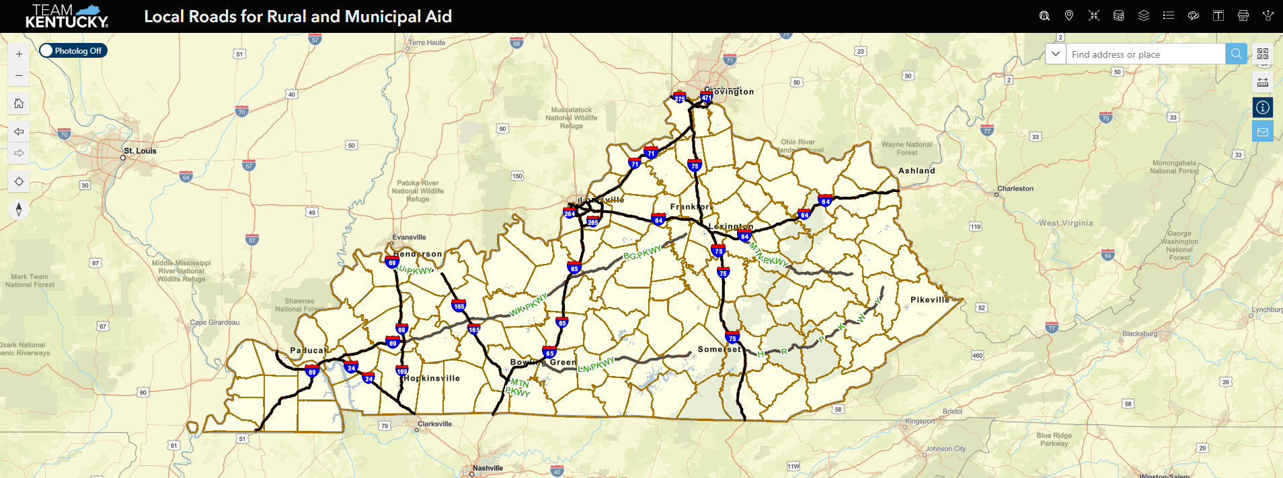

Mapping
https://transportation.ky.gov/Maps/Pages/All-Maps.aspx

Slide 35
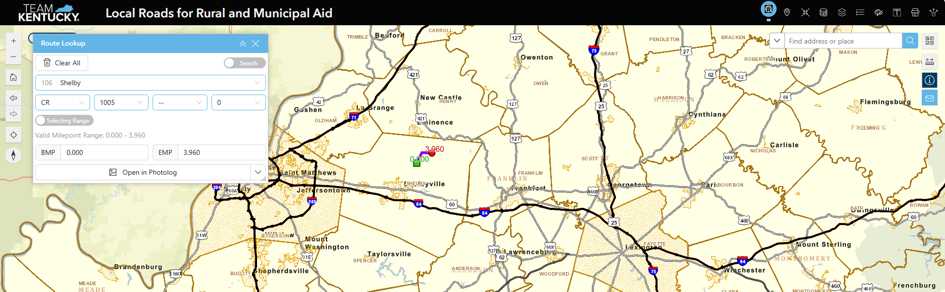
https://transportation.ky.gov/Maps/Pages/All-Maps.aspx

Slide 36
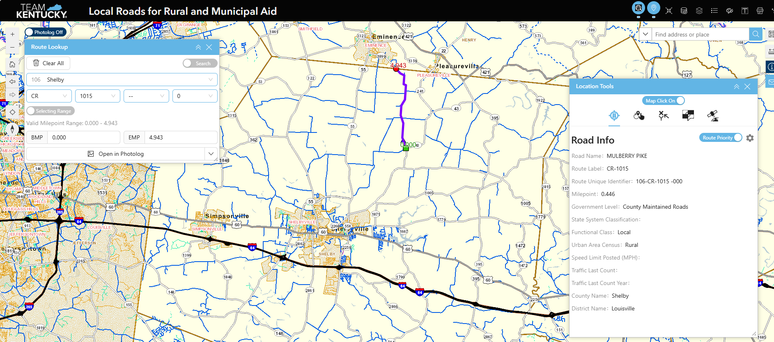
https://transportation.ky.gov/Maps/Pages/All-Maps.aspx

Slide 37
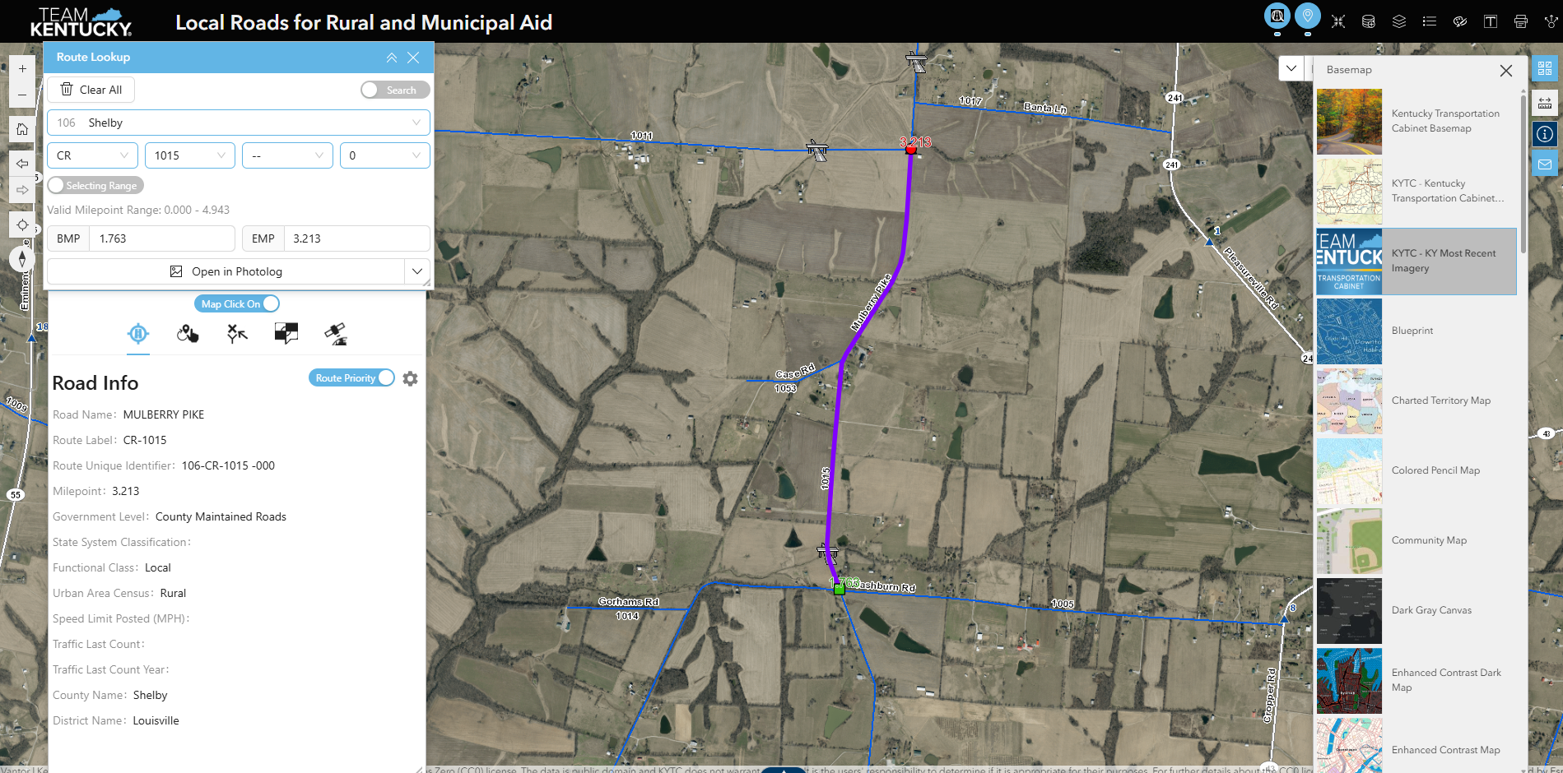
https://transportation.ky.gov/Maps/Pages/All-Maps.aspx
Notes:
The application should read from the intersection of Boone Point (CR 1029) at beginning MP 1.338 extending southwest 1.087 miles to ending mp 2.425.

Slide 38
LEGISLATION PENDING
- HB370 – Addresses special and motor fuel taxes. Establish a single excise tax on gasoline at a base rate of 29.6 cents per gallon.
HB384 – change the revenue-sharing formulation on the portion of motor fuel tax revenue available to county and city road aid funds.
<$775,000,000 = 18.3% for counties & 7.7% for cities
>$775,000,000 = 13% for counties & 13% for cities

Slide 39
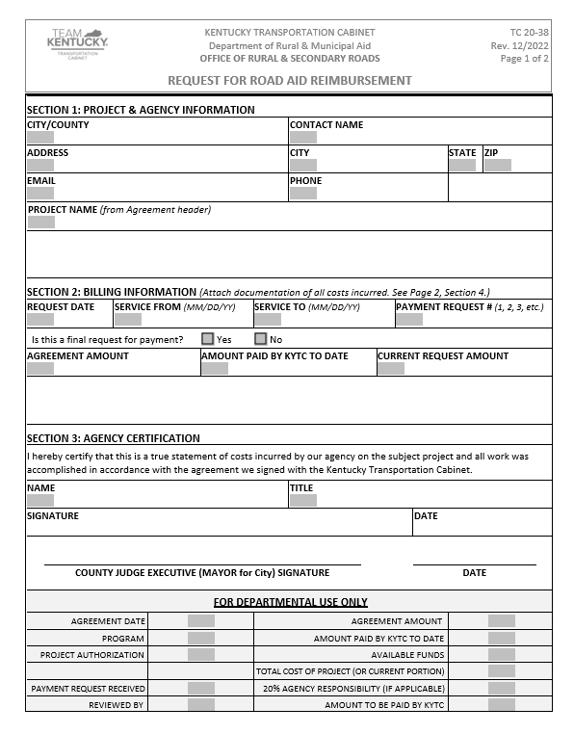
Where Do We Find the Right Forms?
​
https://transportation.ky.gov/Organizational-Resources/Forms

Slide 40
CONTACT INFORMATION
COMMISSIONER'S OFFICE Phone Email Address
Bobbi Jo Lewis (502)892-9022 bobbijo.lewis@ky.gov
Debra Powell (502)871-2822 debra.powell@ky.gov
RURAL AND MUNICIPAL AID
Craig Caudill (859)576-4619 craig.caudill@ky.gov
Kelley Johnson (502)782-5575 kelley.johnson@ky.gov
OFFICE OF LOCAL PROGRAMS
Mike Jones (502)782-4736 michaelr.jones2@ky.gov
Jackie Jones (502)229-6431 jackie.jones@ky.gov
Vicki Barnes (502) 320-1151 vicki. barnes@ ky.gov
Holly Crosthwaite (502)782-4732 holly.crosthwaite@ky.gov
GOVERNMENTAL FIELD SERVICE REPRESENTATIVES
Barry Davis (Eastern) (502)229-0760 barryh.davis@ky.gov
Kenny Morgan (Southern) (502)871-2338 kennym.morgan@ky.gov
Alex Caudill (Western Kentucky) (502) 226-0748 alex.caudill@ky.gov
Greg Meredith (South Western) (270)495-7291 greg.meredith@ky.gov
Jack Couch (Central/Northern) (502) 545-8015 jack.couch@ky.gov
​
EMAIL: RuralandMunicipalAid@ky.gov
QUESTIONS?

